Slide 1

SeqGAN vs LeakGAN:
Text Generation via Adversarial Training

Slide 2
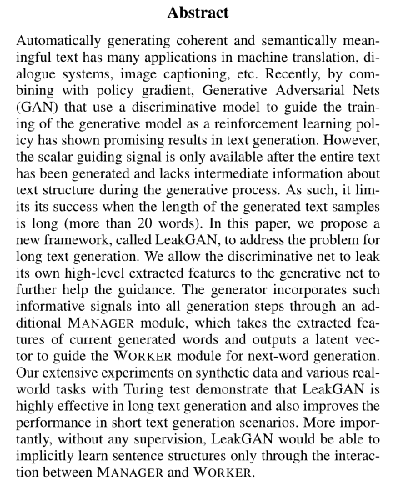


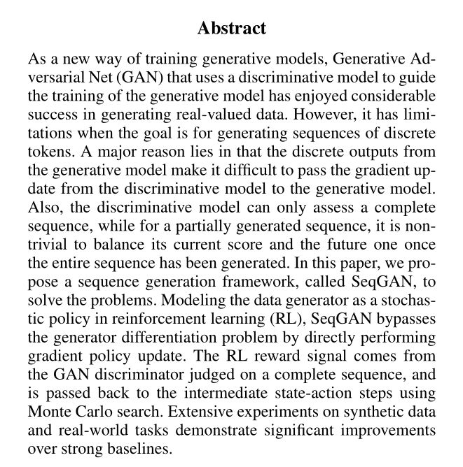

Slide 3
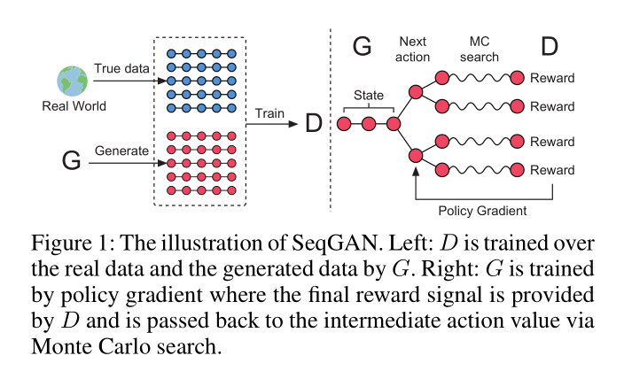
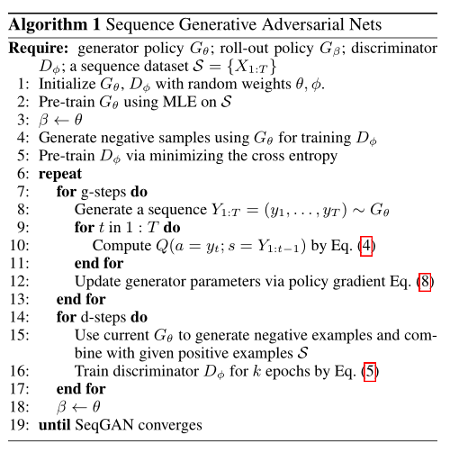
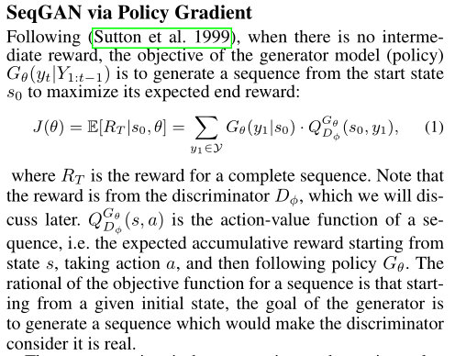


Slide 4
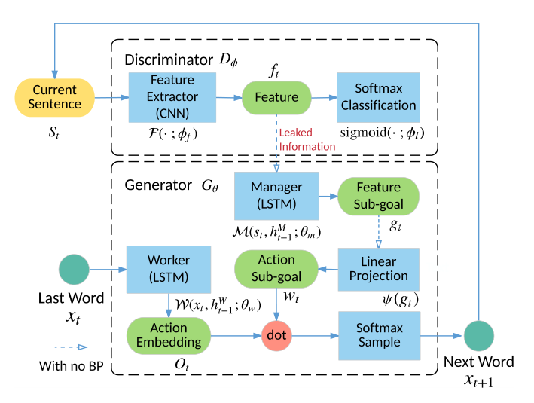
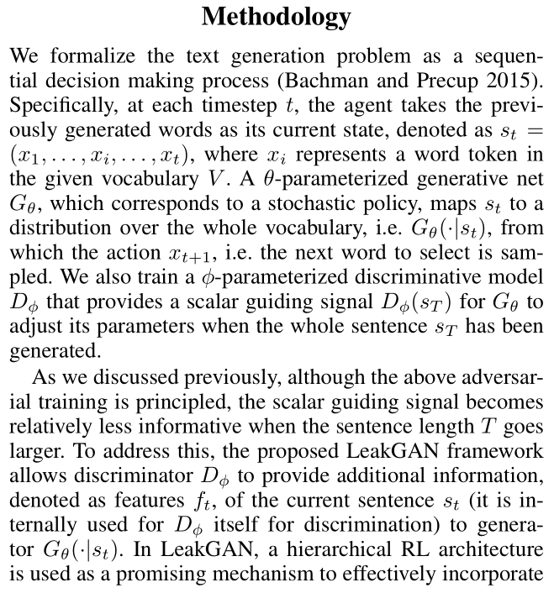

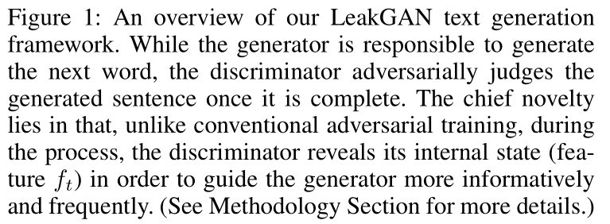


Slide 5
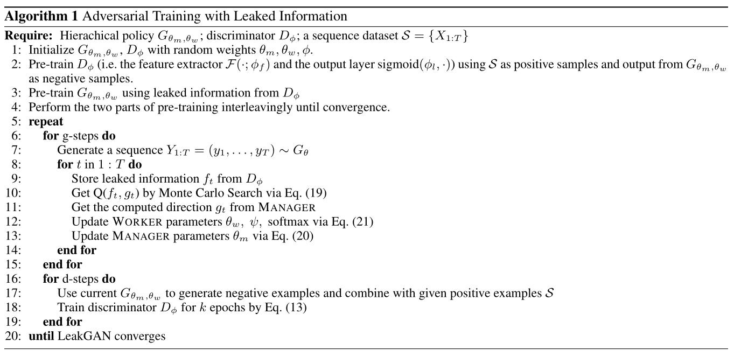
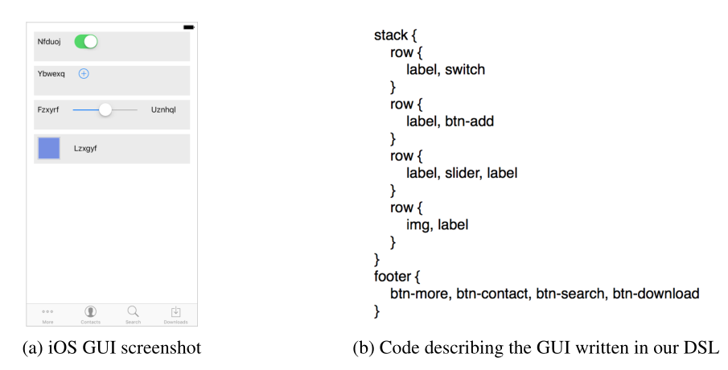

Slide 6
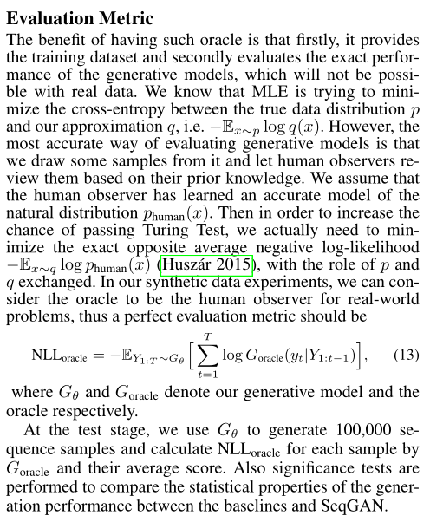
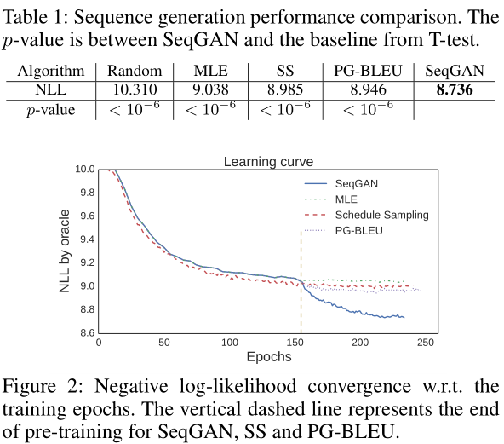


Slide 7
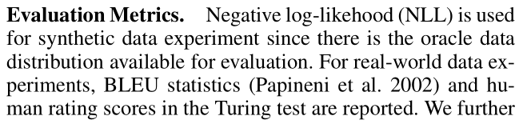

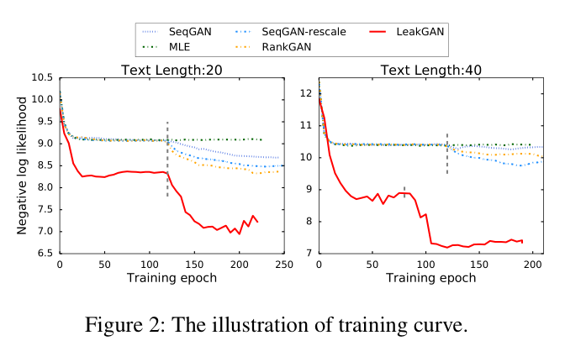
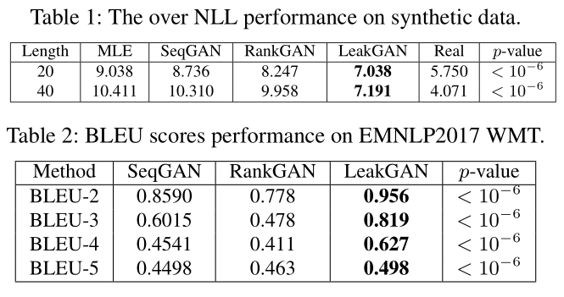

Slide 8
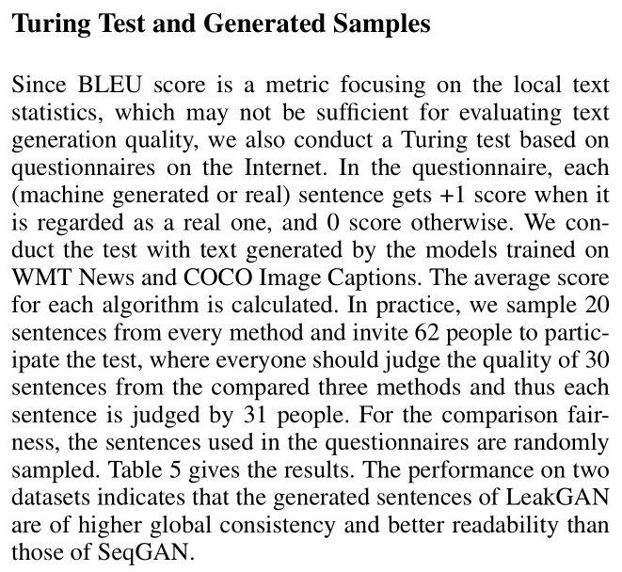
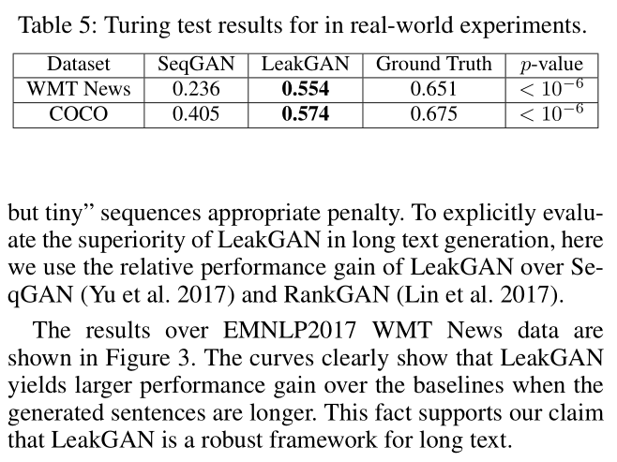




Slide 9
THANK YOU！
PPT模板下载：www.1ppt.com/moban/ 行业PPT模板：www.1ppt.com/hangye/
节日PPT模板：www.1ppt.com/jieri/ PPT素材下载：www.1ppt.com/sucai/
PPT背景图片：www.1ppt.com/beijing/ PPT图表下载：www.1ppt.com/tubiao/
优秀PPT下载：www.1ppt.com/xiazai/ PPT教程： www.1ppt.com/powerpoint/
Word教程： www.1ppt.com/word/ Excel教程：www.1ppt.com/excel/
资料下载：www.1ppt.com/ziliao/ PPT课件下载：www.1ppt.com/kejian/
范文下载：www.1ppt.com/fanwen/ 试卷下载：www.1ppt.com/shiti/
教案下载：www.1ppt.com/jiaoan/ PPT论坛：www.1ppt.cn

